Slide 1

7
Critical Analysis
And Interpretation
E School Maverick 2017
Visualization Competition
Round 2 Submission:Team Invincible
Srijan Goel (Captain) 14102089 7011385619
Shivam Shukla 14102143 8447107702
Saras Chaudhary 14102051 9540527784
Slide Created And Best Viewed in MS Office 2007
Notes:
All the dataset corresponding to each graph has been attached in the notes.
Tools used: Microsoft Excel,Imacros,Infogr.am,Tagul.
Some of the graphs have been visualized on Infogr.am.Since we had only limited access to the website and not an upgraded one, the images of the graphs are not high quality and are only standard quality.

Slide 2
Yearly Crash Trend Analysis
Crash Trend(Reference to Actual Sorted Data of Every Analysis Can Be Found In Notes Section):
The period of 1908-1972 witnessed a steady increase in the number of crashes.
The steep increase between 1939-1945 can be attributed to World War-II.
Moreover, we observed a gradual decrease in the later years.
This indicates better safety standards and regulations adopted by the aviation industry in the
recent decades.
Notes:
Corresponding Data Set for Above Graph:
Year ,Occurrence of Crash In Particular Year 1908 1 1912 1 1913 3 1915 2 1916 5 1917 6 1918 4 1919 6 1920 17 1921 13 1922 11 1923 12 1924 7 1925 11 1926 12 1927 21 1928 37 1929 37 1930 24 1931 32 1932 28 1933 26 1934 30 1935 36 1936 43 1937 27 1938 51 1939 26 1940 18 1941 21 1942 32 1943 39 1944 47 1945 69 1946 80 1947 76 1948 68 1949 60 1950 63 1951 69 1952 61 1953 62 1954 59 1955 52 1956 51 1957 57 1958 62 1959 60 1960 62 1961 52 1962 73 1963 58 1964 69 1965 69 1966 69 1967 91 1968 96 1969 82 1970 87 1971 67 1972 104 1973 89 1974 82 1975 75 1976 86 1977 81 1978 77 1979 89 1980 65 1981 66 1982 70 1983 61 1984 65 1985 74 1986 64 1987 74 1988 83 1989 95 1990 72 1991 88 1992 86 1993 67 1994 87 1995 79 1996 81 1997 68 1998 69 1999 78 2000 76 2001 70 2002 75 2003 61 2004 61 2005 51 2006 49 2007 54 2008 62 2009 24 Grand Total 5268

Slide 3
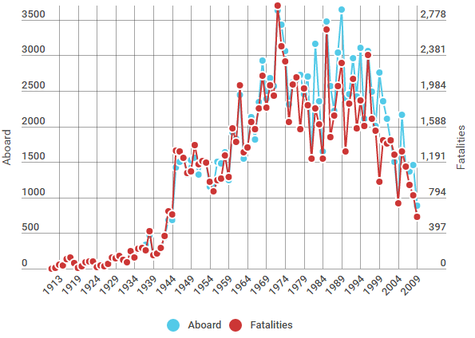
Human Survival Trend In Aircraft Crash
Increasing Survival Rate:
Based on the above observation, it is clearly visible that over the years, the survival rate has increased multifold even in the event of a crash which implies that airlines have tried hard to increase the safety standards within the aircraft for its passengers.
The % fatalities(Data in Notes Section) occurred over the years also shows a decreasing trend.
Notes:
Corresponding data Set for Above Graph:
Year ,Aboard ,Fatalities ,Percentage Fatalities: 1908 2 1 50% 1912 5 5 100% 1913 51 45 88% 1915 60 40 67% 1916 109 108 99% 1917 124 124 100% 1918 65 65 100% 1919 5 5 100% 1920 31 24 77% 1921 69 68 99% 1922 91 80 88% 1923 80 77 96% 1924 18 18 100% 1925 68 39 57% 1926 45 30 67% 1927 73 54 74% 1928 134 124 93% 1929 152 119 78% 1930 176 138 78% 1931 113 94 83% 1932 87 75 86% 1933 212 192 91% 1934 162 126 78% 1935 273 226 83% 1936 312 227 73% 1937 331 203 61% 1938 476 414 87% 1939 184 154 84% 1940 209 169 81% 1941 279 229 82% 1942 442 363 82% 1943 682 642 94% 1944 682 601 88% 1945 1429 1314 92% 1946 1498 1306 87% 1947 1569 1233 79% 1948 1320 1069 81% 1949 1524 1085 71% 1950 1553 1382 89% 1951 1328 1166 88% 1952 1501 1200 80% 1953 1492 1188 80% 1954 1159 973 84% 1955 1180 864 73% 1956 1498 989 66% 1957 1477 1004 68% 1958 1633 1266 78% 1959 1249 1027 82% 1960 1914 1565 82% 1961 1831 1411 77% 1962 2445 2047 84% 1963 1546 1303 84% 1964 1717 1354 79% 1965 2130 1636 77% 1966 1812 1559 86% 1967 2339 1789 76% 1968 2928 2156 74% 1969 2383 1799 75% 1970 2681 2049 76% 1971 2567 1932 75% 1972 3635 2937 81% 1973 3433 2485 72% 1974 3064 2318 76% 1975 2308 1639 71% 1976 2629 2059 78% 1977 2662 2138 80% 1978 2722 1558 57% 1979 2457 2011 82% 1980 2701 1827 68% 1981 1550 1230 79% 1982 3163 1787 56% 1983 2352 1611 68% 1984 1647 1228 75% 1985 3480 2670 77% 1986 2568 1471 57% 1987 2220 1713 77% 1988 3037 2034 67% 1989 3643 2293 63% 1990 2396 1312 55% 1991 2459 1839 75% 1992 2965 2122 72% 1993 2419 1568 65% 1994 3106 1876 60% 1995 2112 1593 75% 1996 3058 2386 78% 1997 2485 1673 67% 1998 2011 1544 77% 1999 2758 970 35% 2000 2357 1429 61% 2001 2111 1398 66% 2002 1798 1437 80% 2003 1508 1276 85% 2004 937 728 78% 2005 2164 1306 60% 2006 1413 1136 80% 2007 1364 931 68% 2008 1463 820 56% 2009 891 581 65%

Slide 4
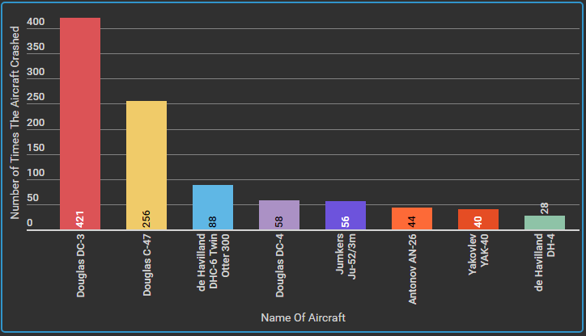
Aircraft-Wise Crash data
Douglas Dc-3 ,Douglas C-47 types of aircraft are more prone to accidents.
Notes:
Corresponding data Set for Above Graph:
Types ,Crashes :de Havilland DH-4 28 Yakovlev YAK-40 40 Antonov AN-26 44 Jumkers Ju-52/3m 56 Douglas DC-4 58 de Havilland DHC-6 Twin Otter 300 88 Douglas C-47 256 Douglas DC-3 421

Slide 5
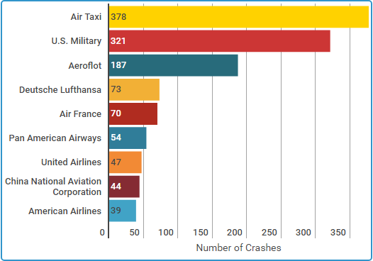
Analysis On The Basis Of Operator
The worst Operators: Air Taxi, U.S.Military (Military - U.S. Army, Military - U.S. Navy, Military - U.S. Army Air Service), Aeroflot worst operators as they have been responsible for maximum crashes.
Notes:
Corresponding data Set for Above Graph:
Operators ,No. Of Crashes: American Airlines 39 China National Aviation Corporation 44 United Airlines 47 Pan American Airways 54 Air France 70 Deutsche Lufthansa 73 Aeroflot 187 U.S. Military(Combined) 321 Air Taxi 378

Slide 6
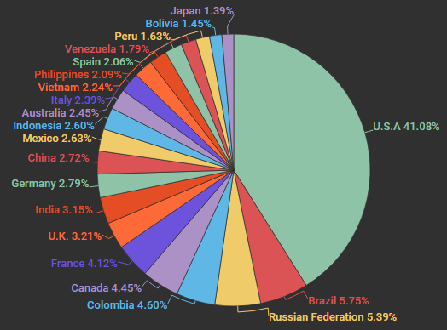
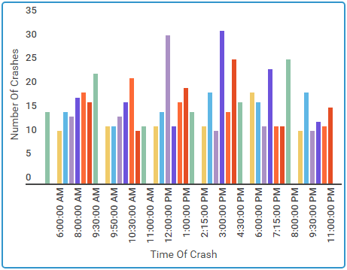
CRASHES WORLDWIDE
Most Risky Route:
U.S.A is more susceptible to crashes.
Its more probable that you will face a crash if you travel over U.S.A than that over any other country.
Time of Crash:
The highest number of crashes occurred at 3:00 PM followed by 12:00 PM from 1908-2009.
This might be attributed to the busy hours.
Notes:
Corresponding data Set for Above Graph:
Country ,Crashes :U.S.A 1357 Brazil 190 Russian Federation 178 Colombia 152 Canada 147 France 136 United Kingdom of Great Britain and Northern Ireland 106 India 104 Germany 92 China 90 Mexico 87 Indonesia 86 Australia 81 Italy 79 Vietnam 74 Philippines 69 Spain 68 Venezuela 59 Peru 54 Bolivia 48 Japan 46 Argentina 44 Congo 44 Angola 43 Egypt 38 Iran 38 Ecuador 34 Nigeria 33 Afghanistan 32 Pakistan 32 Turkey 31 Norway 30 Sudan 30 Greece 28 Guinea 27 Nepal 26 Morocco 25 Chile 24 New Zealand 24 Thailand 24 Switzerland 23 South Africa 22 Kenya 21 Netherlands 21 Romania 21 Ukraine 21 Papua New Guinea 20 Algeria 19 Cuba 18 Honduras 18 Belgium 17 Ethiopia 17 Guatemala 17 Ireland 17 Panama 17 Georgia 16 Saudi Arabia 16 Cameroon 14 Libya 14 Portugal 14 Nicaragua 13 Sri Lanka 13 Costa Rica 12 Malaysia 12 Myanmar 12 Poland 12 Denmark 11 Iraq 11 Sweden 11 Bahamas 10 Bulgaria 10 Uzbekistan 9 Finland 8 Hungary 8 Madagascar 8 Azerbaijan 7 Jordan 7 Lebanon 7 Mongolia 7 Senegal 7 Somalia 7 Gambia 6 Iceland 6 Mali 6 Malta 6 Mauritania 6 Mozambique 6 Samoa 6 United Arab Emirates 6 Uruguay 6 Yemen 6 Dominican Republic 5 El Salvador 5 Gabon 5 Haiti 5 Liberia 5 Paraguay 5 Uganda 5 Zambia 5 Armenia 4 Austria 4 Bahrain 4 Cambodia 4 Cyprus 4 Estonia 4 Fiji 4 Guyana 4 Macedonia 4 Bangladesh 3 Central African Republic 3 Djibouti 3 Kazakhstan 3 Niger 3 Vanuatu 3 Zimbabwe 3 Albania 2 Barbados 2 Belarus 2 Chad 2 Comoros 2 Ghana 2 Kuwait 2 Kyrgyzstan 2 Latvia 2 Luxembourg 2 Malawi 2 Namibia 2 Oman 2 Qatar 2 Rwanda 2 Saint Lucia 2 Sierra Leone 2 Singapore 2 Slovakia 2 Slovenia 2 Solomon Islands 2 South Korea 2 Suriname 2 Turkmenistan 2 Belize 1 Benin 1 Bhutan 1 Botswana 1 Croatia 1 Czech Republic 1 Dominica 1 Eritrea 1 Israel 1 Jamaica 1 Lesotho 1 Lithuania 1 Marshall Islands 1 Mauritius 1 North Korea 1 Taiwan 1 Tajikistan 1 Tunisia 1

Slide 7
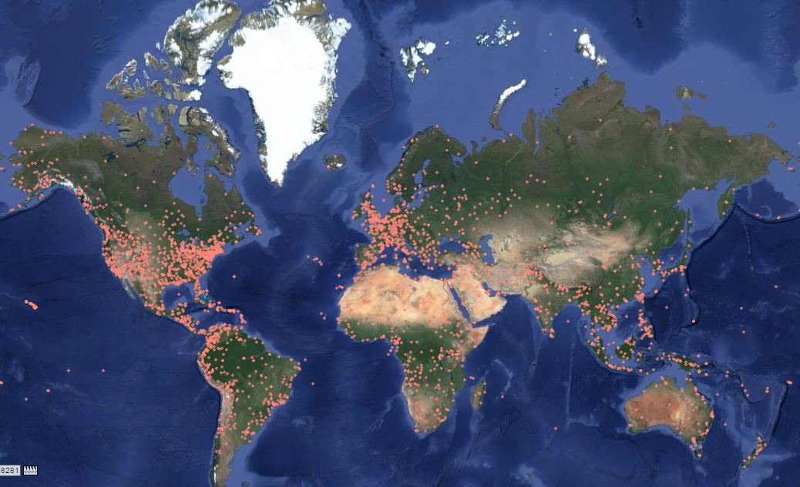
Mapped Data of Every Crash Across The World from 1908-2009
Notes:
Approach to plot Data on Map:
Script was used to paste each of the given location on www.latlong.net and the corresponding value of Latitude and Longitude was obtained.
Hence all the data points obtained were plotted using http://www.hamstermap.com/quickmap.php
Link for dataset(Please open in Incognito tab of Google Chrome if you face any issues):
https://drive.google.com/open?id=0B52jVQj66CmxM25sT0ROX044Qmc

Slide 8


Main Causes Of Plane Crash
Most common reasons for the air crashes(Left Word Cloud): Most crashes occurred due to engine failures, approach, fire, during take- off’s, fog, due to weather, mountains, altitude. As for the route (Right Word Cloud): Flights travelling through or to Alaska(Ak) crashed the most followed by Training Flights, Chicago, Paris.
Notes:
The Corresponding Word-Count obtained from the algorithm:
Omitted :
2363 aircraft
2032 crashed
1826 plane
1182 Crashed
1028 flight
Presented:
937 approach
856 engine
843 runway
823 pilot
726 landing
677 failure
660 crew
592 altitude
577 weather
542 takeoff
538 conditions
534 taking
522 land
491 control
486 mountain
485 ground
457 fire
449 route
449 cargo
438 miles
432 attempting
404 struck
350 left
340 accident
336 airport
323 fog
322 right
318 killed
311 poor
310 feet
301 lost
299 short
298 due
295 terrain
288 Airport
286 failed
286 low
280 loss
274 flying
270 trees
270 wing
267 shortly
260 fuel
259 emergency
245 power
245 area
233 minutes
233 error
230 VFR
227 caused
223 descent
222 high
222 two
208 rain
205 maintain
200 Failure
200 hit
196 heavy
190 Pilot
188 sea
187 turn
181 captain
177 helicopter
174 resulted
173 engines
172 visibility
170 water
168 pilot's
166 flames
165 crash
165 one
164 instrument
160 aboard
159 speed
159 made
158 adverse
156 procedures
155 burned
155 air
150 attempted
149 broke
148 time
146 Improper
145 final
144 collision
141 stalled
140 attempt
139 night
138 airplane
138 gear
137 turbulence
137 found
131 visual
128 near
127 reported
127 pilots
126 took
125 descended
125 system
124 resulting
124 go-around
124 IFR
123 cause
122 course
122 caught
122 field
121 causing
121 Air
120 make
120 flew
117 climb
117 led
116 unknown
114 severe
113 making
113 stall
112 collided
112 take
110 passengers
109 decision
107 hill
106 Struck
105 landed
103 mountains
103 minimum
103 return
101 reasons
101 snow
99 undetermined
99 passenger
99 first
98 mountainous
97 Contributing
97 height
96 attitude
96 named
95 descending
95 burst
95 Shot
95 side
95 went
94 clearance
93 in-flight
93 fatigue
93 Crew
92 steep
92 nose
92 end
91 position
91 later
90 propeller
90 without
89 exploded
89 tried
89 ATC
88 thunderstorm
88 continued
88 lack
86 maintenance
86 entered
86 use
85 icing
82 follow
81 Continued
81 military
81 contact
81 back
79 procedure
79 Shortly
78 cabin
77 aircraft's
77 following
77 One
76 training
76 three
76 ocean
76 level
75 inadequate
75 cockpit
74 carrying
74 overran
74 forced
74 dive
73 second
73 radio
73 winds
73 rate
72 avoid
72 Flew
71 factor
71 clouds
71 Runway
71 safe
71 ILS
70 Mountain
70 airspeed
70 began
70 tail
69 became
69 fly
67 occurred
66 improper
66 ran
65 prescribed
65 warning
65 radar
65 tower
64 wreckage
64 elevator
64 Engine
64 may
63 destination
63 operation
63 Cause
63 came
63 part
62 approximately
62 airliner
62 adequate
62 fuselage
62 unable
62 missed
62 just
61 contributing
61 result
61 wooded
61 bank
60 experiencing
60 Midair
59 crashing
59 impacted
59 proper
59 south
58 experienced
57 properly
57 killing
57 another
57 losing
56 thunderstorms
56 followed
56 factors
56 rudder
56 ice
55 explosion
55 aborted
55 strong
55 along
55 north
54 instruments
54 condition
54 captain's
54 Possible
54 thrust
54 onto
54 Lake
54 shot
53 Inadequate
53 controls
53 action
53 rotor
53 Lack
53 Loss
53 main
53 jet
52 disorientation
52 separation
52 separated
52 Island
52 flaps
52 prior
52 never
52 able
51 destroyed
51 building
51 ceiling
51 rolled
51 lights
51 Force
50 planning
50 Factors
50 clear
50 cloud
50 mile
50 San
49 maneuver
49 leading
49 fighter
49 Cessna
49 planes
49 impact
49 crew's
49 River
49 four
49 path
48 disappeared
48 climbing
48 members
48 gain
48 rest
48 Fuel
48 Two
48 oil
47 diverted
47 several
47 beyond
47 jungle
47 storm
47 lines
47 wings
47 tank
46 encountered
46 inverted
46 decided
46 safely
46 Poor
46 last
45 meteorological
45 insufficient
45 Disappeared
45 recovery
45 observed
45 degrees
45 descend
45 center
45 trying
45 ridge
45 used
45 Lost
45 see
44 International
44 structural
44 initiated
44 design
44 turned
44 houses
44 door
44 tree
44 mail
44 stop
44 New
43 approaching
43 subsequent
43 overloaded
43 returning
43 excessive
43 ditched
43 wrong
43 line
43 bomb
42 sufficient
42 reference
42 continue
42 suffered
42 seconds
42 trouble
reduced
Frequency of words in Route Data:
159 ak
122 city
98 san
87 training
79 de
77 chicago
76 paris
75 ca
73 newyorkcity
69 new
64 london
62 la
60 los
60 afb
58 angeles
53 rome
51 rio
50 miami
50 lake
49 st
49 bogota
46 moscow
46 island
45 ny
41 tx
41 port
40 sao
40 mexico
39 las
39 cairo
38 manila
38 anchorage
37 washington
35 york
35 santa
35 sanfrancisco
34 newark
34 england
33 fort
32 el
32 denver
31 sightseeing
30 seattle
30 paulo
30 il
30 detroit
29 vegas
29 janeiro
29 hong
29 fl
29 buenos
29 aires
28 nj
28 kong
28 honolulu
28 burbank
28 bay
27 wa
27 nv
27 co
27 athens
27 amsterdam
27 ab
25 mo
25 flight
25 c
24 tokyo
24 paz
24 nc
24 az
23 test
23 pa
23 nm
23 mi
23 lima
23 kansas
23 dallas
23 bangkok
22 santiago
22 d
21 salt
21 puerto
21 madrid
21 jakarta
21 delhi
21 cleveland
21 brussels
21 berlin
20 villavicencio
20 tehran
20 juan
20 france

